Slide 1
Enhancing productivity: Lockout limit
Group Members:
Omer Khalid 23K-0529
Maaz Khan 23K-3036
Abdul Jibran 23K-3014

Slide 2

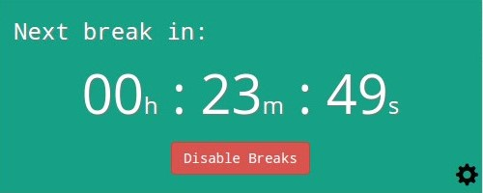
Prelude
Today, we are thrilled to present an innovative solution designed to revolutionize the browsing experience for every user. In a world having immense distractions, our team has recognized this issue and is here to present our Chrome extension primly focused on optimizing productivity through enhancing the quality of time management for the user. Lockout limit empowers you to take control of your online time and polish your punctuality as it prevents the user from exceeding the provided time limit, deliberately reminding him of his next task. In today’s era, users find difficulty to stop themselves from going astray when surfing online, and end up wasting their time, and this is where Lockout Limit strikes, as it will prompt the user after a certain period to come back where they left.

Slide 3






Hurdles in the way
Entertainment websites such as social media platforms i.e. Facebook, Instagram and X (twitter) along with streaming services most commonly Twitch, can drain one’s productivity as they can captivate the user for a prolonged period and waste their time.
Habitual excessive browsing on certain sites can have adverse affects on mental health since constant influx of unnecessary information or exposure to negative content can create a sense of depression, inadequacy or anxiety.
Keeping constant checks on your notifications and frequent scrolling through endless feeds can also reduce one’s attention span, and make it difficult for the person to concentrate for a long period of time or stay deeply concentrated.

Slide 4

Solution overview
By limiting the users usage of the internet and blocking the site once the timer is over, our extension will prove to be fruitful for the user in handling time more efficiently.
Access to entertainment sites for a prolonged period and involuntarily wastage of time can be reduced, enhancing one’s focus on the goal they tend to achieve through internet and not remain astray.
Time punctuality can be harnessed once the user get habitual of completing their tasks on time and fulfilling the reason for which they accessed the internet.

Slide 5
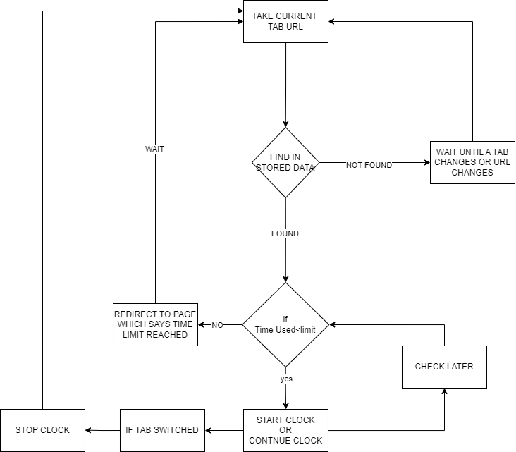
DEMO

Slide 6
Technical Aspects
Technological Stack:
HTML,CSS,JAVA SCRIPT
API’S USED IN JS:
Chrome API ,URL API, Storage API
CHROME API
STORAGE API
URL API
Used to get URL of the current Tab. It is also used to update the URL to redirect to a page which say timer ran out when time limit is reached.
The Storage API is used to used to store timer-related data in the local storage of the Chrome browser.
URL API is used to convert the current tab URL into an object from which we can retrieve hostname.
E.g.
From: https://www.youtube.com/watch?v=xvtmMA1zb-k
It gives only:
www.youtube.com

Slide 7

User Benefits
Time Management:
1.Can control amount of time spent on websites.
2.Personalized limits.
Mindful Usage:
Increases Awareness of web usage. Which can lead to healthier lifestyle.
Customized Restrictions:
1.Settings can be adapted to personnel work or study structure.
2.Tailored Time Limits according to individual preferences.
How it works?
Set Your Own Limits:
1. Set time limits for specific websites.
2. Easily change time limits within the extension settings.
Monitoring:
1. Notifications when time limits approach.
2. Check your entire days time on web.
Encourages Breaks:
1. Reminders to take breaks and maintain a healthy online-offline balance.
2.Enhance overall well-being with a mindful approach to technology.

Slide 8



Usage scenarios
Productivity and focus:
Students or professionals seeking to boost work rate and visualize a clear-cut objective with pinpoint accuracy.
Health concerns:
Users looking to rejuvenate their health and revitalize their mental energy.
Parental control:
Parents trying to restrict their children from surfing the web for prolonged periods of time.
Time management:
Users searching for ways to seamlessly manage tight schedules,
and ensuring there is ample time for other activities by intelligently distributing time for
different websites and domains.

Slide 9



Future developments
Improved UI based on user feedback.
Increased browser compatibility so that the extension works on many browsers.
Availability of the extension in multiple languages.
Added functionalities, like timer recommendations for different websites commonly visited by users.
Regular updates to fix bugs, improve performance, and add new features based on technological advancement.

Slide 10

conclusion
In conclusion, our extension aims to boost overall productivity and time management of users, allowing them to follow a set routine without issues. The involvement of JSON, HTML, CSS and JS files, along with various APIs, will allow our extension to function and ensure that the user can reap the various benefits of it fully. User feedback will create room for improvement in our extension, allowing for additional features and functionalities to be incorporated.
All of you are encouraged to try out our extension. Your feedback is very valuable to us.

Slide 11

QnA session

